Slide 1
Code 210 Procurement Operations Division Training Session:
Overview of the New NASA Procurement Internal and External Websites
210/Jim Becker
June 5, 2018

Slide 2
Knowledge Management Team
KM TEAM KM COMMUNITY OF INTEREST TEAM
Barbara Trujillo (HQs) Melissa Newell (AFRC)
Dan Walt (HQs) Elisaban Rodriguez (ARC)
Sonya Harmon (HQs) Paden Chang (ARC)
Geoff Sage (HQs) Rachel Jandron (ARC)
Lisa Jackson (AFRC) Jennifer Perez (GSFC)
Chris Signorino (ARC) Tyrone Wright (JSC)
Gary Shelley (ARC) Wendy Crisman (JSC)
Allison Sandt (MSFC) Didetsa Vazquez Soto (KSC)
Robin Strohacker (GRC) Michele Berdux (NSSC)
Jim Becker (GSFC) Kenneth Albright (NSSC)
Dawn Fountain (GSFC) Mike Kaszyca (LEAD) (LaRC)
Rosalie Carpentier (JSC) Erica Jones (MSFC)
Edwin Martinez (KSC) Kiera Span (MSFC)
Kari Desmarais (KSC)
Helena Wilkas (KSC)
Tracy Siegel (LaRC)

Slide 3
Knowledge Management Team
KM TEAM
Dawn Turner (MSFC)
Patrick Whelan (NSSC)
Tracy Hall (NSSC)
Tony Goretski (SSC)

Slide 4
Knowledge Management Components
Communities of Practice
Training Technical Community
TYPES:
Source Selection
Pricing
Others as required
Knowledge Management Portal
Lessons Learned
KM overarching approach:
Strategic Plan including
Governance and
Communications Plan
Case Studies
Tools
-Videos
-weblinks
LEVELS:
Agency
Center
Project
Subject matter

Slide 5
Knowledge Management Program Platforms
Procurement External Site
https://ww.hq.nasa.gov/office/procurement/
https://www.nasa.gov/office/procurement/
Procurement Internal Site
NEW InsideNASA
https://inside.nasa.gov/procurement
Community of Practice
https://nen.nasa.gov/web/op
Procurement Internal Site (NAIS)
(Phased migration to New InsideNASA)
https://prod.nais.nasa.gov/cgibin/nais/index.cgi
Lessons Learned Information System
https://nen.nasa.gov/web/ll/
NASA Tube
https://nasatubedev.nasa.gov/
OP Tools
https://inside.nasa.gov/ecs/approved-collaboration-tools

Slide 6
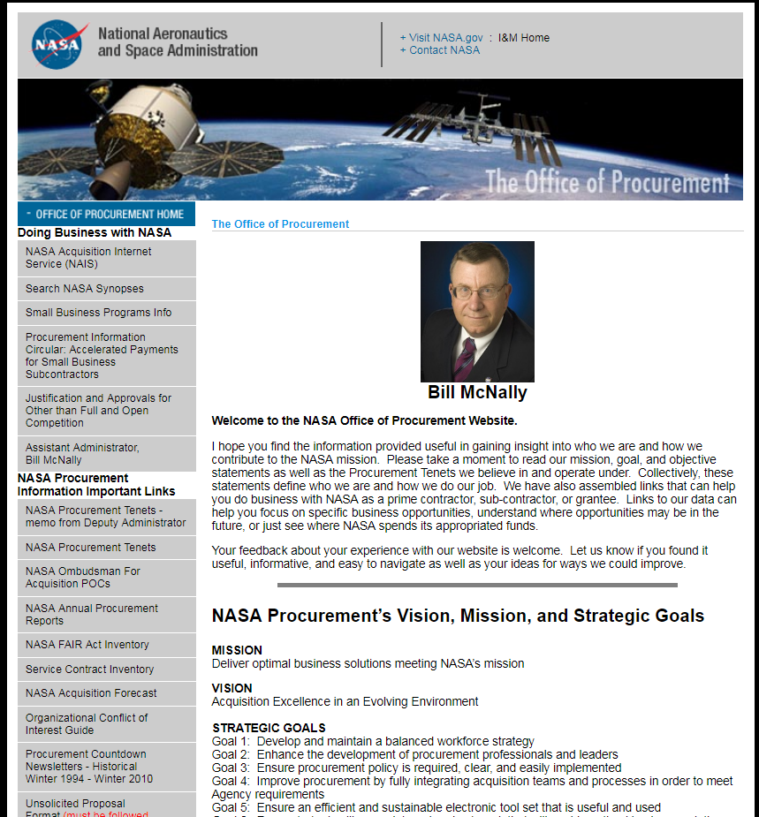
The HQ OP public facing “Bill page” is replaced by…
New Procurement Websites

Slide 7
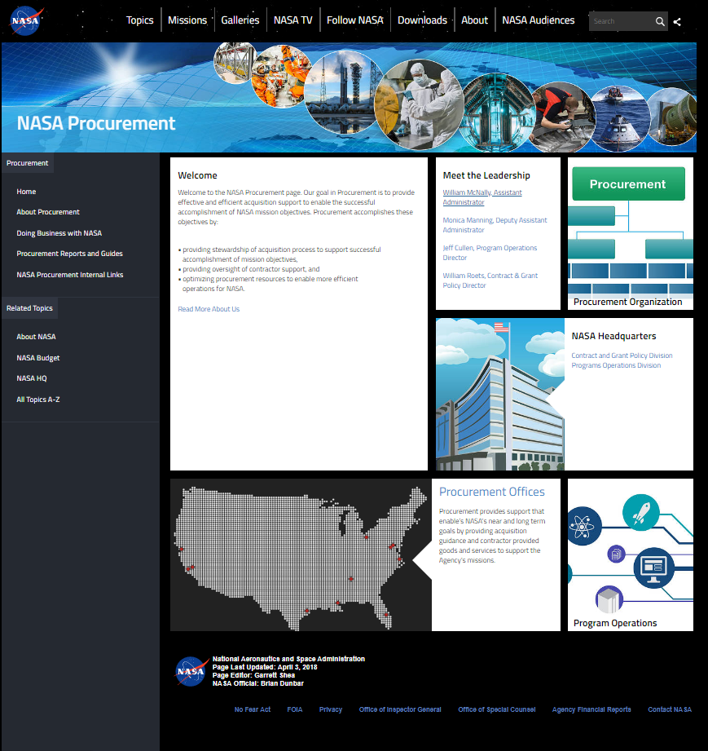
…the “external” InsideNASA site.
New Procurement Websites
Links to:
About Procurement
Doing Business with NASA
Procurement Reports and Guides
NASA Procurement Internal Links
https://www.nasa.gov/office/procurement/

Slide 8
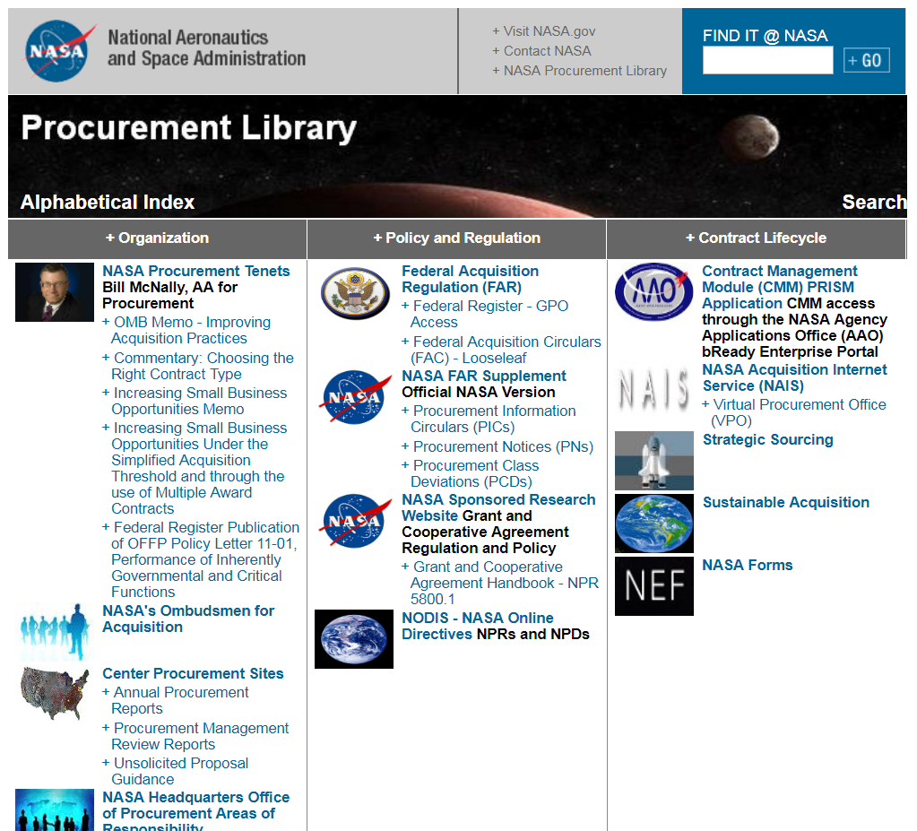
The Procurement Library is replaced by…
New Procurement Websites

Slide 9
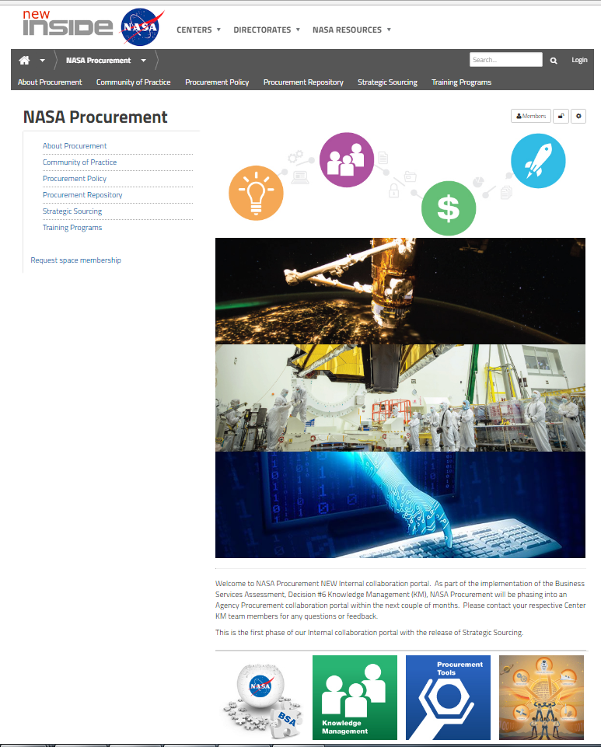
…the Inside NASA “Internal page”.
New Procurement Websites
Links to:
About Procurement
Communities of Practice
Procurement Policy
Procurement Repository (Knowledge Bank)
Strategic Sourcing
Training Programs
https://inside.nasa.gov/procurement

Slide 10
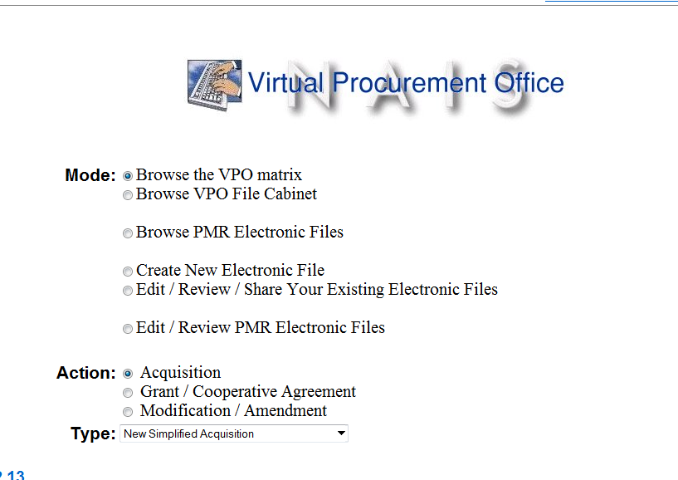
The VPO is replaced by…
New Procurement Websites

Slide 11
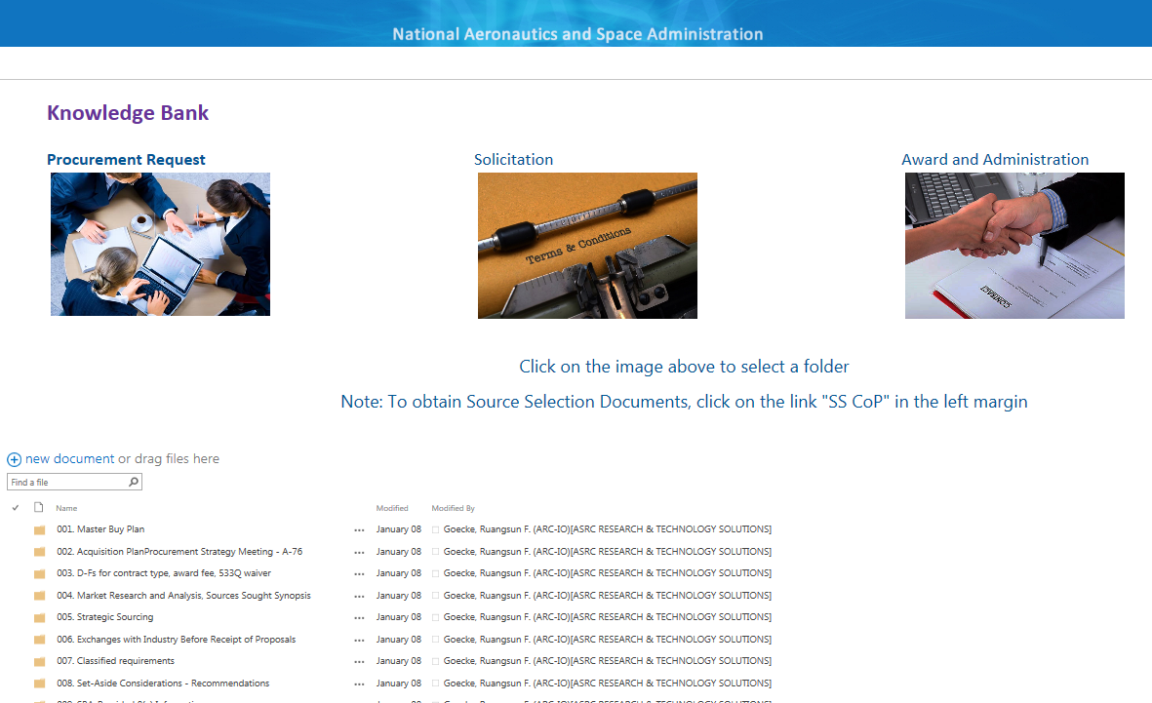
…the Knowledge Bank.
New Procurement Websites
Contains documents from HQ and the Centers
100 folders mirror PPS and cover the entire procurement process
Each of the 100 folders have 4 subfolders:
  Templates – Forms – Checklists
  Policy – Guidance
  Lessons Learned
  Training
Content Managers from each Center and HQ oversee the files and share File Location Matrices with Users
Source selection sensitive documents are kept by the SS CoI. A list of SS CoI members are provided via a link.

Slide 12
NFS Strategic Sourcing Requirements
1805.7001 General.
The contracting officer shall complete and submit the information specified on the Office of Procurement Strategic Sourcing Publicizing Instructions webpage not later than thirty days after award of an Agency-wide contract, Multiple Center-wide contract, and Center-wide contract. [Definition of Agency-wide, Multiple Centers, and Center-wide contract can be found on the Office of Procurement Strategic Sourcing website.]
1807.105 Contents of written acquisition plans.
* * * * *
(b) Plan of action.
(1) Discuss consideration, in coordination with Agency and Center CFO, CIO, or other program offices as necessary, given to the –
(i) Use of existing government-wide contracting opportunities established as Federal Strategic Sourcing Initiatives (FSSI), such as FSSI procurement vehicles for express and ground domestic delivery services and the use of NASA’s Strategic Sourcing Initiatives (NSSI); NSSI includes Agency-wide contracts, Multiple Center-wide contracts, Center-wide contracts, and Enterprise License Management Team program (see NFS 1807.70 and Office of Procurement Strategic Sourcing Searchable Repository); any other agency strategic sourcing initiatives.

Slide 13
NFS Strategic Sourcing Requirements
1808.003-7201 Policy.
Requiring offices and contracting officers shall follow the guidance at 1808.004 and Government wide commercial purchase cardholders shall follow the guidance at 1813.301 to make use of the existing NASA contracts that are available for use by other Centers to satisfy requirements for supplies and services. The use of NASA contracts that are available for use by other Centers allows NASA to obtain favorable terms and pricing for supplies and Services as described in the Office of Procurement Strategic Sourcing website.
1808.003-7202 Purchase request.
Prior to submitting a purchase request, the requiring activity shall review the existing NASA contracts that available for use by other Centers as identified on the Office of Procurement Strategic Sourcing Searchable Repository to determine if the requirement is available through the NASA Strategic Sourcing Initiative.

Slide 14
NFS Strategic Sourcing Requirements
1808.004 Use of other sources.
(a)(1)(A) For requirements for supplies or services that cannot be satisfied from the mandatory sources listed at FAR 8.002 and 8.003, the contracting officer shall satisfy such requirements through an existing mandatory NASA contract as follows—
(i) NNX11AA01C - Agency Consolidated End -user Services (ACES);
(ii) NNX16MB01C - NASA Enterprise Application Service Technologies 2
(EAST 2); and
(iii) NNM11AA04C - NASA Integrated Communications Services (NICS). Additional information on the mandatory NASA contracts is available on the Office of Procurement Strategic Sourcing Searchable Repository.
(B) For situations (e.g., immediacy of need, availability of better pricing elsewhere, etc.) that do not warrant the use of the contracts determined as mandatory in 1808.004(a)(1)(A), the contracting officer shall prepare and submit a request for deviation for approval by the Assistant Administrator for Procurement in accordance with 1801.471.
(C) For NASA contracts that are not identified as mandatory but identified as available for use by other Centers on the Office of Procurement Strategic Sourcing Searchable Repository, the contracting officer should use these NASA contracts to obtain favorable terms and pricing for supplies and services and to support NASA’s strategic sourcing goals.

Slide 15
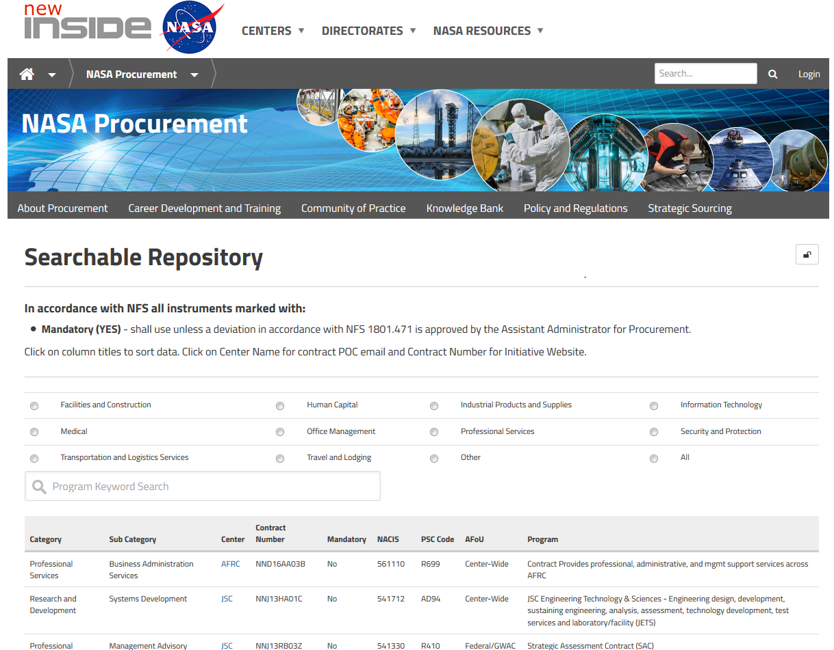
Office of Procurement Strategic Sourcing Repository

Slide 16
New Procurement Websites
Please review the new sites and provide feedback
One of the goals of the Knowledge Management team is to continually improve the new procurement websites and to do that we need your help.
Please explore the new sites and share your likes, dislikes, suggestions, etc. with GSFC’s Content Managers:
  Jim Becker
  Deb Kaelberer
  Michele Rook

Slide 17
NASA Procurement Website Addresses
InsideNASA Procurement Internal site:
https://inside.nasa.gov/procurement
InsideNASA Procurement External site:
https://www.nasa.gov/office/procurement
ARC SharePoint repository (Knowledge Bank)
https://intranet.share.nasa.gov/arc/acquisitions/KnowledgeManagementRepository/Forms/Landing%20Page.aspx
NASA Engineering Network (NEN) Procurement Community of Practice
https://nen.nasa.gov/web/op

