Slide 1
Procurement Business Services Assessment (BSA) Decision 7 Project Management for Acquisitions
Code 210 All Hands
May 25, 2017

Slide 2
Project Management for Acquisitions
Decision 7:
“Apply Project Management Principles to the acquisition process and establish a consistent methodology to enable a more efficient measurement practice for tracking procurements and Contractor Performance with the goal of significantly reducing lead-times and selecting the best Contractor for all procurements.”

Slide 3
BSA Decision 7 Team
GRC
HQ
Dawn Pottinger
Jaya Bajpayee
Gayk (Tony) Dzhordzhalyan
Barbara Mader
Richard McCarthy
Kathy Nado
ARC
Uyen Tu
Jill Willard
(Gary Heagy, retired)
GSFC
LaRC
Cindy Cherrix
Nick Nemecek
Suzanne Sierra
Mary Ann Tolodziecki
Andrea Thomas
AFRC
LaShonda Jacobs-Terry
Wendy Pennington
Joel Sitz
JSC
NSSC
KSC
Wendy Crisman
Mark Chadwick
MSFC
Jeff Lamke
Rob Stute
Keith Hefner

Slide 4
Project Management “The discipline of initiating, planning, executing, controlling and closing the work of a team to achieve specific goals and meet specific success criteria.” for Acquisitions

Slide 5
Project Management for Acquisitions: Tools
7
decision
TEAM
4 SUBTEAMS
INTRODUCTION TO PMA
TEAM CHARTER
COMMUNICATIONS PLAN
MILESTONE SCHEDULES

Slide 6
Decision 7 Sub-Teams
INTRODUCTION TO PMA
Provides the rationale for using Project Management tools and processes as a method of managing the acquisition process.
Lead: Suzanne Sierra
Wendy Pennington
Nick Nemecek
Andrea Thomas
Mary Ann Tolodziecki
TEAM CHARTER
Addresses mission and objectives, roles and responsibilities, and team operations.
Lead: Jaya Bajpayee
LaShonda Jacobs Terry
Dawn Pottinger
COMMUNICATIONS PLAN
Defines to whom, what type, when, and how information will be disbursed.
Establishes the frequency for providing internal updates to the team members about the progress, establish a timetable, and evaluate the results. Implement a plan to ensure issues and concerns are raised in a timely manner.
Lead: Kathy Nado
Jill Willard
Rick McCarthy
MILESTONE SCHEDULES
Detailed milestone schedules, as well as individuals responsible, for all activities.
Co-Lead: Wendy Crisman
Co-Lead: Mary Ann Tolodziecki
Suzanne Sierra
Uyen Tu
Jill Willard

Slide 7
Introduction to Project Management for Acquisitions

Slide 8
The Schedule
A Project Management for Acquisitions Tool
The Project Management for Acquisitions Schedule Templates provide a detailed acquisition schedule that is designed to facilitate the acquisition process
The schedule should be created early in the planning stages and should have team buy-in
Three versions of the acquisition Schedule Template have been developed to accommodate the acquisition complexity, various technical skill levels of each user, as well as the software available to the acquisition team
Each template contains the same identified tasks, recommended lead-times, and columns for identifying the Responsible Party per task, as well as identified predecessor tasks
Each template is modifiable and allows the team to identify applicable tasks for their acquisition
Responsible parties should be assigned to each applicable milestone
The schedule should be reviewed on a regular basis with the team members throughout the acquisition process to track task progress and completion, troubleshoot issues, and to predict any potential issues that may arise
Regular reporting on the status of the acquisition to Center Management is essential to ensure potential issues are resolved in a timely manner

Slide 9
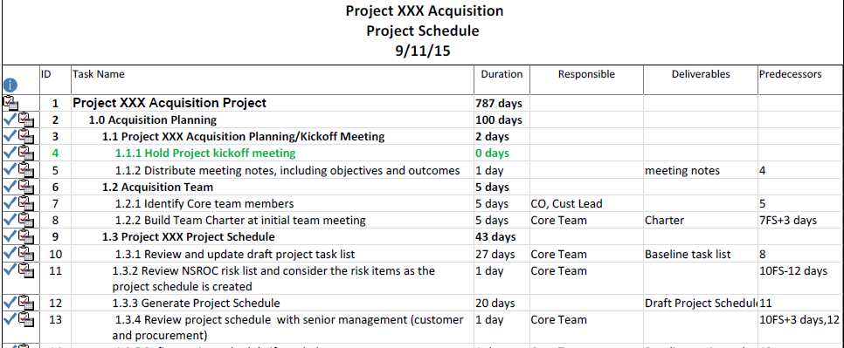
Schedule Templates
Basic Excel Template with identified milestones and recommended lead-times, but no calculations
Advanced Excel Schedule contains a prepopulated schedule and calculations based on recommended lead-times
MS Project Schedule Template allows the team to use additional MS Project functionalities (critical chain, base-lining)

Slide 10
Implementation / Change Management
Development of tools alone is not sufficient to ensure the Project Management for Acquisition (PMA) process is embraced by all.
Implementation / Change Mgmt
Plan to use Knowledge Management Team’s portal for PMA tools and process information.

Slide 11
Success Metrics
Project Management Plan is routinely used.
Acquisitions remain on schedule.
Minimal changes to schedule.
Impact of schedule changes are minimal.
Assigned deliverables are completed by the target date.
Proper and effective communication channels are utilized.
SUCCESS METRICS
Milestone Schedules & Tools are flexible to accommodate all Agency needs.
Timely identification of issues/concerns and reported to appropriate personnel.

