Slide 1
NASA/Goddard Space Flight Center’s Office of Procurement
Code 170
Office of Procurement
All Hands
February 2024

Slide 2
AGENDA
2023 Year in Review/2024 Look Ahead
(Mary Stevens)
Self Assessment/PMR Preparation/EVS
(Brian Leyda)
What’s New in the World of Systems
(Maryann Tolodziecki)

Slide 3
2023 Year in Review
2024 look ahead

Slide 4
Procurement Obligations* FY 2014– FY 2023
* GSFC/HQ documents minus bank cards and outside buying (PGrps beginning with G* and H*, not GSFC/HQ Plant/Money obligated by NSSC).

Slide 5
FY23 Actions | Contracts | BPAs | CA's | PO's | Calls/Orders | IAAs | Total
Base | 68 | 4 | 0 | 10 | 216 | 39 | 337
Mod | 1,984 | 136 | 13 | 24 | 1,216 | 295 | 3,668
Total Actions | 2,052 | 140 | 13 | 34 | 1,432 | 334 | 4,005
Total FY Obs | $2,879,451,838 | $0 | $32,013,050 | $11,360,876 | $378,317,911 | $322,339,796 | $3,623,483,473

Slide 6
AWARDED SEBs
CSDAP
GXS
OMES
ROME
Commercial Small Sat Data Acquisition Program
GeoXO GXS Instrument Implementation
Omnibus Multidiscipline Engineering Services 3
Repair, Operations, Maintenance & Engineering
GXI
NSROC-4
QS-SMOS
SEAS-2
GeoXO Imager Implementation
NASA Sounding Rockets Operations Contract-4
QuickSounder
Systems Engineering Advanced Services 2

Slide 7
MAJOR COMPETITIONS IN PROCESS
1
ACX
7
FDSS IV
13
LISA
19
RSDO IV
GeoXO ACX Implementation
Flight Dynamics Support Services IV
Flight Model Telescope
RSDO IV On-Ramp-3
2
AOS-I
8
GDC
14
LLH
20
SENSE
Atmosphere Observing System Inclined Spacecraft
Geospace Dynamics Constellation
LISA Laser Head
Space Exploration Network Services Evolution Follow-on
3
ATMOS
9
GLOMAS
15
LMX
21
SMAS III
Atmosphere Support
Global Modeling and Assimilation Support
GeoXO LMX Implementation
Safety and Mission Assurance Services 3 Follow-on
4
DATSS
10
GLSC
16
NSN Cat 1
22
SWNL1A-COR
Data Analysis and Technical Support Services
Goddard Logistics Services Contract
Near Space Network Category 1
Space Weather Next Coronograph
5
ESES-4
11
GX Spacecraft
17
NSN Cat 2
23
SWNL1A-SC
Electrical Systems Engineering Services-4
GeoXO Spacecraft Implementation
Near Space Network Category 2
Space Weather Next Spacecraft
6
ETIS IV
12
LANDIS
18
OCX
24
WRC
Environmental Test & Integration Services IV
Landsat Next Instrument Suite
GeoXO OCX Implementation
Wallops Range Contract

Slide 8
LOOK AHEAD TO CY 24
Reestablish the Code 170 Climate Advisory Team
PO/DPO engagement at the office level
Maintain partnership with OSBP, meeting/exceeding all Small Business goals
CLP Earning Period expires 4/30/24
Continue to support the Enterprise in development of Agency Policy
Reduce the Closeout/unliquidated obligation backlog working with the Closeout Assistance Team (CoAT) and Closeout Contractor
HQs Performance Management Review (PMR) Coming July 2024
Focus on Contract Administration Activities
Continue focus on OP Performance Metrics and Data Analytics

Slide 9
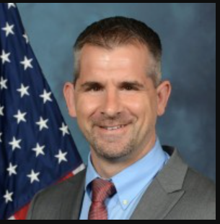
HIGHLIGHTS: OUR PEOPLE
OP approved new management model for GSFC which provides for 2 Deputy Positions supporting the Procurement Officer:
- Deputy PO for Acquisition (Nipa Shah)
- Deputy PO for Policy (Brian Leyda)
Brian Leyda was selected as
Code 170’s Deputy for Policy.
Congratulations Brian!

Slide 10
Welcome New Code 170 members
12 New Employees have joined GSFC since February 2023
and now support our organization
Brian Leyda – Code 170
Travis Hagelberg – Code 171
Ricardo Perez – Code 171
Kevin Cook – Code 172
Avery Stevenson – Code 178
Eric Hausdorfer – Code 173
Michelle Lansberg – Code 174
Robert Donohue – Code 174
Jeannelle Zayas-Bazan Ayala - Code 178
Jonathon Diggs – Code 175
Mathew Riggs (Detail)
Nicholas Booth – Code 177
Stephanie Bailey – Code 174

Slide 11
FY23 Office of Procurement Enterprise Awards
Contract Specialist of the Year (Pre-Award)
Tiffanie Ferrell
James Kim
Early Career Contract Specialist of the Year
Notes:
Alphabetical and doublecheck names/awards

Slide 12
HIGHLIGHTS: OUR PEOPLE
DDP and Code 170/200 DEIA MODDI Committee
DAVID BOON – Veterans Employee Resource Group (GOVets), Management Operations Directorate Diversity and Inclusion (MODDI) Committee
Karen Smith – LGBTQ+ Employee Resource Group, Management Operations Directorate Diversity
Cassandra moore - Diversity Dialog Program (DDP)
Makara Nevils - Diversity Dialog Program (DDP), Management Operations Directorate Diversity and Inclusion (MODDI) Committee
Malika graham- Diversity Dialog Program (DDP)
DEVONA JACKSON - Management Operations Directorate Diversity and Inclusion (MODDI) Committee
Tiera greene - Diversity Dialog Program (DDP)
MICHELLE DELANEY - Management Operations Directorate Diversity and Inclusion (MODDI) Committee
Forestine Robinson – Women’s Employee Resource Group and Network (WEN), Diversity Dialog Program (DDP) Facilitator; Management Operations Directorate Diversity and Inclusion (MODDI) Committee
Monica Allen – Women’s Employee Resource Group and Network (WEN), Diversity Dialog Program (DDP) Facilitator, Management Operations Directorate Diversity and Inclusion (MODDI) Committee

Slide 13
THANK YOU
PROGRAM NOMINEES
* Craig Keish * Cassandra Moore
* Anne Kearney * Shani Smith
* Kyle Vann

Slide 14
NASA Headquarters PMR Support
The following individuals supported HQ’s Procurement Management Reviews during 2023:
Jonathon Wingerberg - JSC
Terri Patterson – NOJMO
Dona Vanterpool - NOJMO

Slide 15
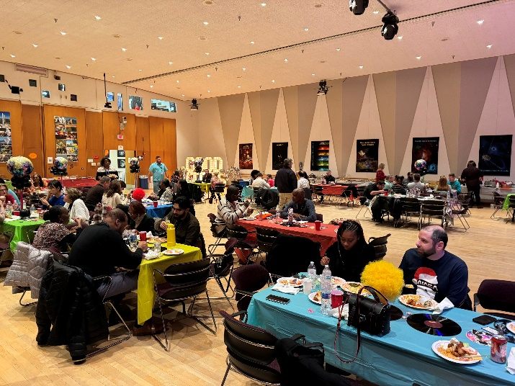
Workplace Climate Initiatives
EOY Recognition Social held on October 11, 2023.
Special thank you to the Code 170 Holiday Planning Team “Groovy 70’s Holiday Party”!
Zakia Bright, Maikeyza Brown, Chanda Cannon, Andres Castro, Leah Correa, Bria Cromartie Whitehead, Candis Edwards, Maria Fleming, Alexis Harris, Deanna Herschel, Maria McNamee, Miranda Meyer, Cassandra Moore, Wanda Moore, Lisa Mullen, Kellie Murray, Carlos Natera, Jennifer Oconnell, Sol Shinn, Kyle Vann, Eboni Washington, Sherika Wilson

Slide 16
Self Assessment/FEVS

Slide 19
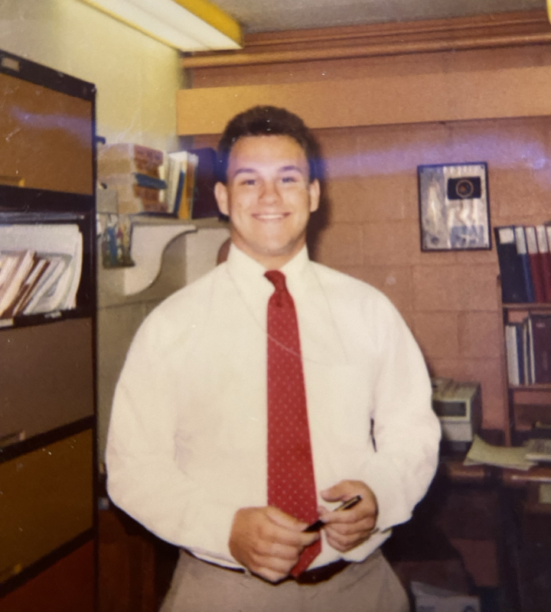
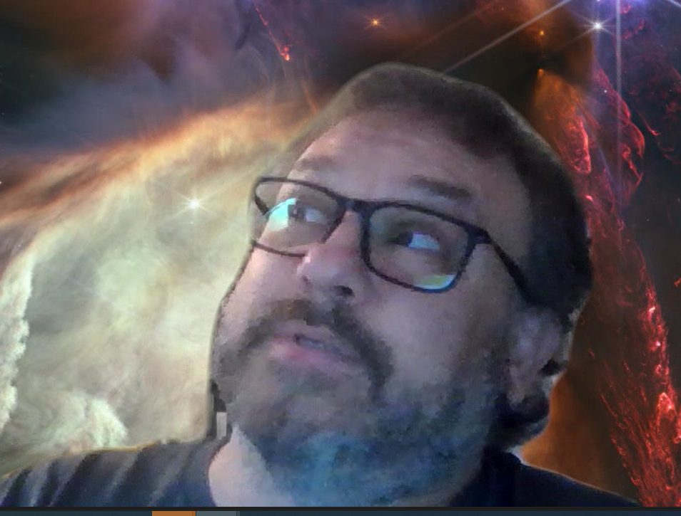

Slide 20
Code 170 Self Assessment(SA)
Self Assessment covers the period from July 1, 2022 – June 30 2023.
Summary – 5 Strengths, 11 Weaknesses and 7 Recommendations
Strengths (Data Quality, Protests, Sole Source, Surveillance Plans, Closeout)
Weaknesses (NF1098, PALT + timeliness, BPA Annual Reviews, CPARS, Small Business Concerns, Award Fee Eval System, JOFOCs Posting, Elements of Cost/Reasonableness, Source Selection Statement Postings, Options)
Recommendations (File Hygiene, Sole Source Tech Evals, Fee Negotiations, IAA D&F, Sam Checks, Task Order Rates/Tech Evals, Modifications)
Corrective Action Plan (CAP)– Series of recommendations that will be tracked by HQ to resolution. First update due 15 March

Slide 21
SA Next Steps & Acknowledgements
Near Term Actions
Review the Self-Assessment (sent 26 January)
CO Forum on 27 Feb
CAP Progress/Tracking
Medium Term Actions
Implement improvements based on findings in the Self Assessment
PMR Prep
CAP Resolution
Acknowledgements: HQ Scorecard for the GSFC Self Assessment Quality = 100%
Thanks to the following volunteers:
Tina Jenkins
Darlene Harkins
Jasmine Taylor
Leona Ellis
Daniel Breedlove
Devona Jackson
Karen Smith
Jonathan Diggs
Jacob Perez
Sang Lee
Christopher King
Daniel Han
Craig Keish
Andres Castro
Makara Nevils
Michele Rook
Suzanne Sierra
Cindy Cherrix
Maryann Tolodziecki
Eric Newman

Slide 22
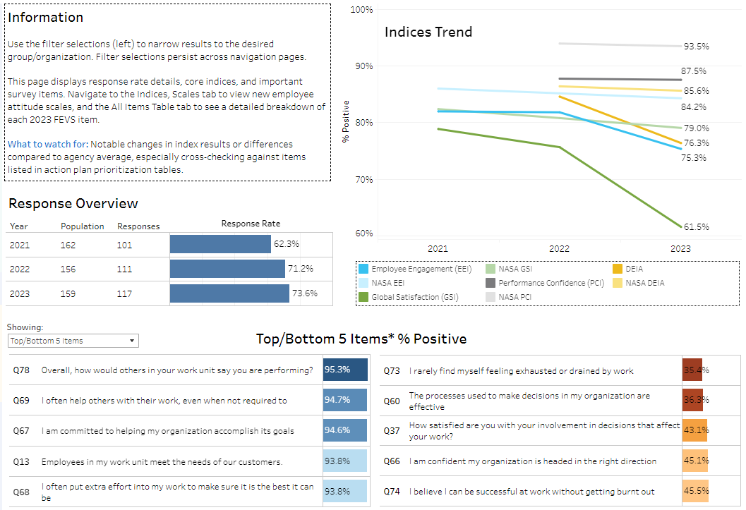
2023 FEVS Results

Slide 23
FEVS Strengths & Concerns
GSFC OP Strengths
High Commitment to meeting mission/agency needs
“My Work Unit” ratings are generally very high
Teamwork is highly valued and appreciated
Immediate Supervisors are rated highly. Respect, trust and confidence are all emphasized.
Staff feel like the work is high-quality and contribute positively to the Agency performance
.
GSFC OP Concerns
Heavy workload and resulting burnout (Q73)
Significant decrease in Satisfaction (from 76% to 62%)
Differences in performance not recognized appropriately (Q39 and Q11)
Information flow down from Senior Leaders
Low confidence that issues reported in FEVs will result in improvements (Q21)

Slide 24
Improvements & Next steps
Telework Posture CAT Team
Emphasis on actionable solutions
Quarterly tracking and deliverable
Focus on addressing concerns and largest negative responses
New Systems
Better systems create efficiency
Possible “Silver Bullet”
CO Forum
Open format enables us to address existing and new issues

Slide 25
What is new in the world of systems

Slide 26
E-Business Systems Office (EBSO) & Enterprise Procurement Business Process Analyst (EPBPA)
The E-Business Systems Office (EBSO) was established under OP’s Enterprise Service and Analysis Division (ESAD) to provide E-Business support at an Enterprise level
The EBSO has cognizance over:
E-Business procurement systems that enable the acquisition workforce at NASA
SAP is a core financial system supported by the Applications and Platform Services (APS) Office
Internal and external OP websites
All efforts to define and govern system data (standardization and analysis) used to manage OP services
The creation of Procurement dashboards, metrics, and other analytical data tools to provide greater insight into the procurement function across the Enterprise
Each Center has an Enterprise Procurement Business Process Analyst (EPBPA) to serve as the Center focal point and liaison for all EBSO supported applications and data, and the Center advocate assisting in the integration of E-Business efforts and developing optimized strategies for enterprise OP Solutions and E-Business initiatives

Slide 27
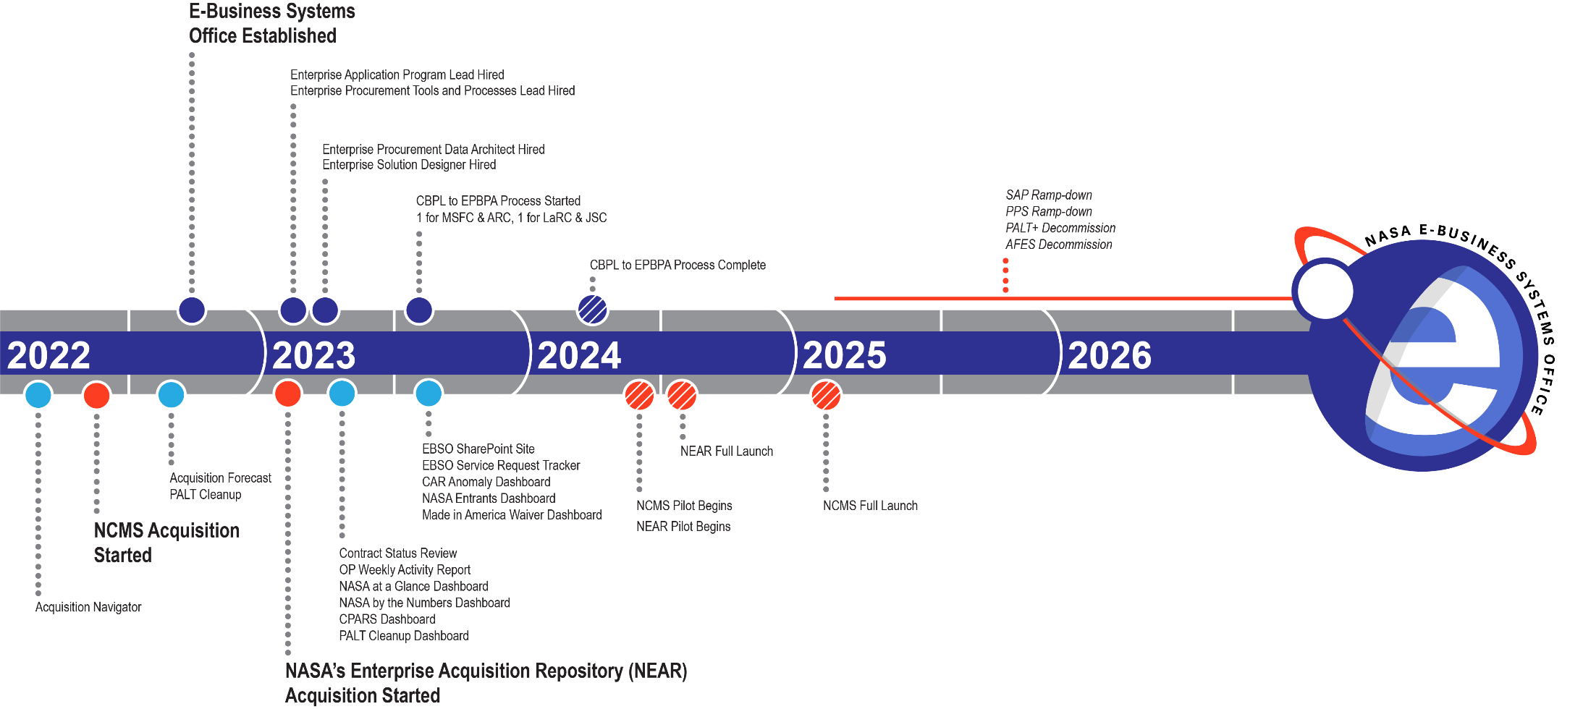
EBSO Activities In-Flight

Slide 28
NASA Integrated Enterprise Environment (NIEE) and NASA Enterprise Acquisition Repository (NEAR)

Slide 29
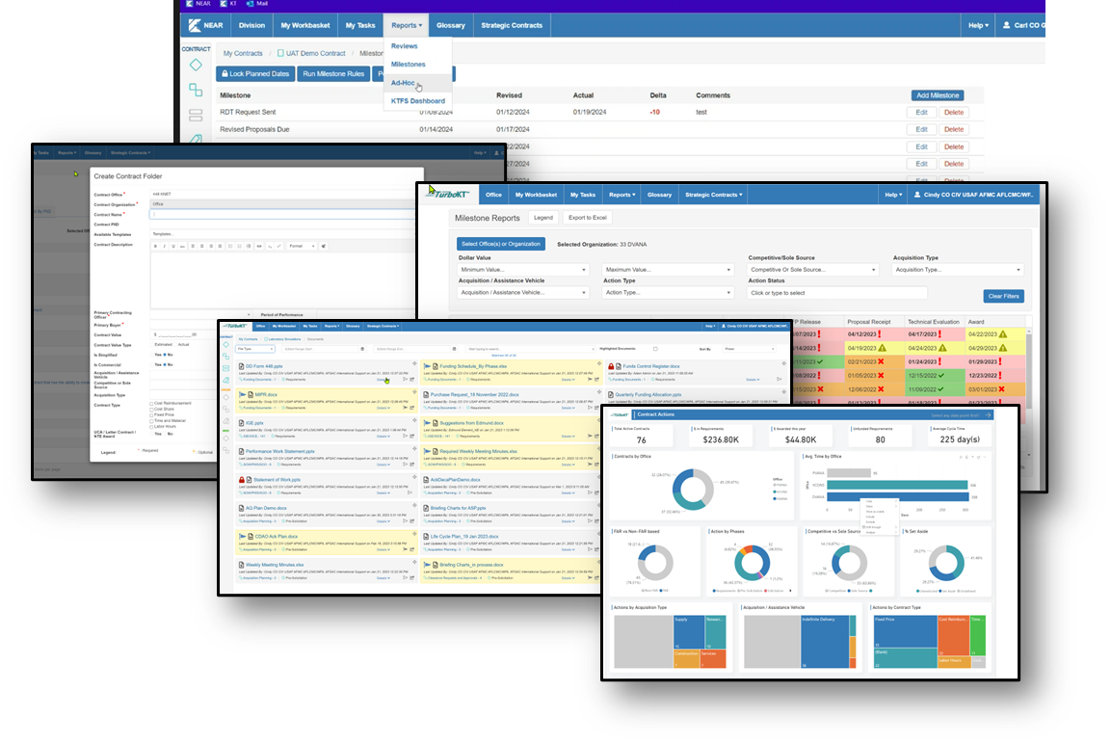
NASA Enterprise Acquisition Repository (NEAR)
Targeted to Go-Live at Pilot Center/MSFC & HQ OP April/May 2024
Targeted to Go-Live at Remaining Centers by October 2024
Some Highlights:
Microsoft SharePoint Based
Contract Folder Creation w/Filtering and Bookmarking​ Actions for Quick Access
Automatic Milestones Tracking and Reports​
Contract File Summary
Generalized document routing will be provided for COs to select up to 20 end-users at a time to review, concur, approve a document; Routing will allow for parallel and sequential reviews.
Integrated Reporting via Dashboards

Slide 30
NASA Contract Management System (NCMS)

Slide 31
NASA Contract Management System (NCMS)
The EBSO office will hold the responsibility for administration, business analyst and functional support for the application, as well as taking over the training role once the system is fully deployed at the agency.
Core Capabilities for contract authoring:
Acquisition Planning
Solicitation and Authoring
Document Management
Reporting
Contract Administration
NEAR complements NCMS for routing, review and approvals

Slide 32
E-Business System Office (EBSO) Dashboard & Metrics

Slide 33
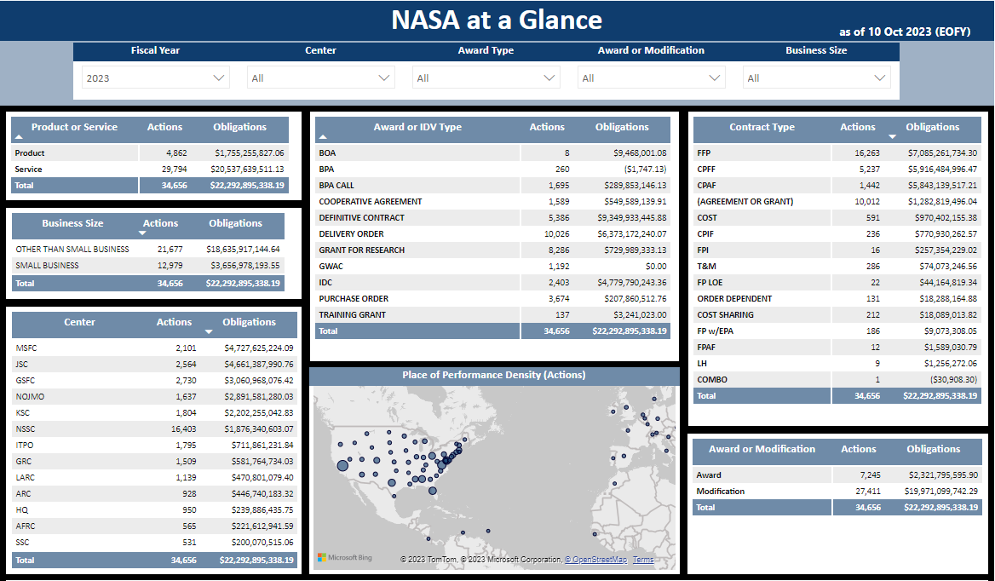
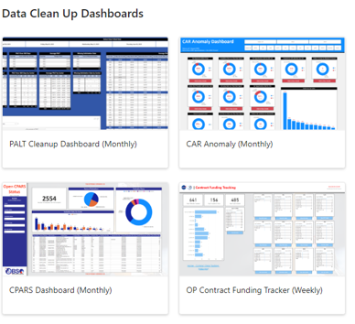
EBSO Metrics & Dashboards
Consistent NASA Data and Metric Reporting
Data Clean Up Dashboards
Center Data Quality Improvement Plan
Quarterly validations of data will be required

Slide 34
G-Invoicing (Not an EBSO Supported Application)
The G-Invoicing process & systems should be used for awards with a period of performance beginning 10/1/2024
Until both NASA and its Trading Partners are live in G-Invoicing, we will continue to use our legacy processes utilizing the 7600 forms manually in accordance with Treasury’s G-Invoicing Rules of Engagement
NASA will begin ‘brokering’ GT&Cs (7600A) with Trading Partners in April 2024 to have them approved and entered into G-Invoicing for future Ordering
Data will be captured/coordinated/approved outside of G-Invoicing; once approved data entry can occur
Trading Partner approvals will be replicated in GT&C
Creation of the Order (7600B) / Obligations can occur in SAP (Manual Entry) after GT&C approval as of 10/1/2024
SAP has been be modified for new G-Invoicing fields as applicable
SAP Obligations will interface to G-Invoicing for Order creation
Trading Partner will initiate a ‘Performance Transaction’ which kicks off the Inter-Governmental Payment and Collection (IPAC) process
Treasury is cutting off direct IPAC processing as of 10/1/2025 (this impacts existing, “in-flight orders”)
NASA’s target is to transition IFOs is 4/1/2025
Begin looking at long term IAAs and IAAs awarded fiscally
Use of 7600A and 7600B forms today can facilitate the transition into G-Invoicing
Trading Partners must work together on how to transition IFOs
Procurement will utilize a Fiori Hub in lieu of G-Invoicing to view G-Invoicing documents: GT&Cs, Orders and Performance Reporting & Invoicing

Slide 35
THANK YOU
For your
Dedication
resilience
and
Support!
Questions?

