Slide 1
NASA/Goddard Space Flight Center’s Office of Procurement
Code 170
Office of Procurement
All Hands
April 2023

Slide 2
AGENDA
2022 Year in Review
2023 Year in Ahead

Slide 3
Past / current year challenges/initiatives
Return To work Transition
Adapting to hybrid process of using both onsite and off-site work locations
Renewed co-worker interactions
Retirements/Loss of Personnel
New Requirements/Initiatives
Foreign Travel Country Clearance Requirement Statement
DEIA Requirement Statement
NASA Acquisition Innovation Launchpad
PALT+ Reporting and Data Analytics

Slide 4
Past / current year challenges (CONT)
Continued changes Enterprise Operating Model
HQs PPM/ERM input in development of acquisition strategies
New processes in personnel management and hiring practices
Continue move away from PPS and back to SAP
Establishment of the HQs Enterprise Pricing Office
High volume of work (including SEBs), GSFC continues to lead Agency in the number of actions processed.

Slide 5
Significant Accomplishments
Code 170 Self Assessment
OP reviewed GSFC’s Self-Assessment and scored GSFC @ at 88.
Kudos to Eric Newman and Susan Beury and their team members for this effort.
Excelled in the Following Key Metrics:
Number of Actions Reviewed
Corrective Actions Completed
Data Quality (FPDS-NG)
PALT
COR Training
Procurement Training
One Critique:
CPARS – Expectation of more metric data in future assessments

Slide 6
LOOK AHEAD TO CY 23
Focus on equity and fairness in all Division practices
Reinvigorate Code 170’s Climate Advisory Team (CAT)
Maintain partnership with OSBP, meeting/exceeding all Small Business goals
Continue communication of changes from Enterprise Operating Model
Continue to support the Enterprise in development of Agency Policy
Reduce the Closeout/unliquidated obligation backlog working with the Closeout Assistance Team (CoAT) and Closeout Contractor
Implement FAC-C Modernization Policy
Continue focus on OP Performance Metrics and Data Analytics
PO engagement at the office level

Slide 7
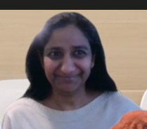
HIGHLIGHTS: OUR PEOPLE
OP approved new management model for GSFC which provides for 2 Deputy Positions supporting Procurement Officer
- Deputy PO for Acquisition
- Deputy PO for Policy
Nipa Shah selected as Code 170’s
Deputy for Acquisition
Congratulations Nipa!
The selection of the Code 170 Deputy for Policy is currently in process

Slide 8
Welcome New Code 170 members
19 New Employees have joined GSFC since October 2021
and now support our organization
Daniel Breedlove – Code 173
Raven Maxim – Code 176
Chanda Cannon – Code 173
Ravi Palaniandy – Code 178
Andrew Fiedler – Code 173
Susan Beury – Code 170
Christopher King – Code 177
Jacob Perez – Code 175
Jeffrey Kirk – Code 178
Devona Spivy-Jackson Code 174
Gion Lalican – Code 176
Adam Sponsky – Code 177
Miranda Meyer – Code 176
Kelly Torres -- Code 177
Sara Nipwoda – Code 174
Zakia Bright – Code 176
Conor Hyatt – Code 176
Pavi Tumbapura – Code 178
Sol Shin – Code 174

Slide 9
FY22 Office of Procurement Enterprise Awards
Procurement Support Person of the Year
Trina Haffelfinger
Procurement Supervisor of the Year
Eric Newman
Group Award—Aircraft Operations & Maintenance (O&M) Product Service Line (PSL) Procurement Team
GSFC O & M Team:
Mary Stevens Theresa Patterson Kyle Vann Alisha Mercadante
Notes:
Alphabetical and doublecheck names/awards

Slide 10
Congratulations to code 200 awardees!
LEADERSHIP QUALITY
Alexis Harris
GOLD STAR
Michael Levy Lisa Bednarik Michele Connerton Spencer Hurd
HONORING EXCELLENCE
Anthony Lyas Andres Castro
Building 23 C242 Advanced Avionics Development ESD Labs:
David Boon
TEAMWORK / PARTNERSHIP
GSFC UESC Team (15 Buildings):
INNOVATION
Karen Smith Raymond Jones Kyle Vann
SUPERVISOR OF THE YEAR
Maria McNamee
Notes:
Alphabetical and doublecheck names/awards

Slide 11
HIGHLIGHTS: OUR PEOPLE
DDP and Code 170/200 DEIA MODDI Committee
DAVID BOON – Veterans Employee Resource Group (GOVets), Management Operations Directorate Diversity and Inclusion (MODDI) Committee
Karen Smith – LGBTQ+ Employee Resource Group, Management Operations Directorate Diversity and Inclusion (MODDI) Committee
Cassandra moore - Diversity Dialog Program (DDP)
Makara Nevils - Diversity Dialog Program (DDP), Management Operations Directorate Diversity and Inclusion (MODDI) Committee
Malika graham- Diversity Dialog Program (DDP)
Tiera greene - Diversity Dialog Program (DDP)
Forestine Robinson – Women’s Employee Resource Group and Network (WEN), Diversity Dialog Program (DDP) Facilitator
Monica Allen – Women’s Employee Resource Group and Network (WEN), Diversity Dialog Program (DDP) Facilitator, GSFC Anti-Harassment Coordinator, Management Operations Directorate Diversity and Inclusion (MODDI) Committee

Slide 12
Workplace Climate Initiatives
EOY Recognition Social held on October 26, 2022. Virtual event with WFF on November 16, 2022.
Special thank you to the Code 170 Holiday Planning Team “Let’s Mingle and Jingle”!
Carlos McKenzie 176
Sherika Wilson 176
Denise Byrd 176
Dean, Genia 171
Washington, Eboni 175
Hart, Russellyn 173
Mccree, Janicea L. 174
Willingham, Keisha 173
David Boon 174
Delaney, Michelle 174
Harris, Alexis 178
Tracey Jones 172
Alisha Mercadante 176
Gunter, Leigh A. 176
Eric Newman 171
Antwan Reid 176
Martyn, Sholainka O. 179
Moore, Wanda B. 177
Tammy Seidel 172
Graham, Malika 178
Freeman, Nathan A. 178
Charis Murray 171
C

Slide 13
EVS Program Feedback & Next steps
Code 170 Highest Rated Questions

Slide 14
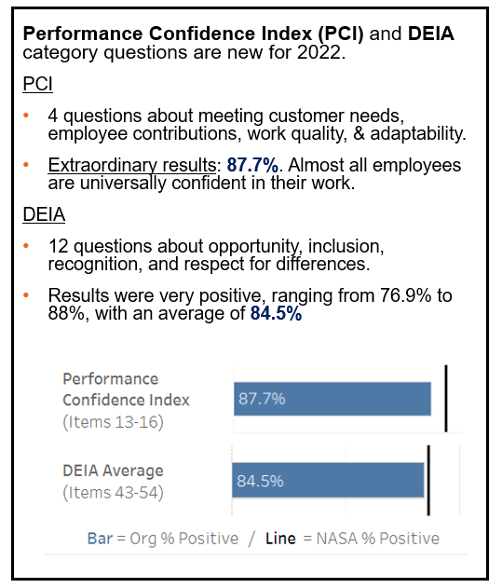
EVS Program Feedback & Next steps
.

Slide 15
EVS Program Feedback & Next steps
Notable Questions Needing Focus:
Largest Decreases from 2021
Satisfaction
“How satisfied are you with your involvement in decisions that affect your work”
Largest decrease (↓ 12.5%)
Organization
“Employees in my organization are protected from health and safety hazards on the job”
Second largest decrease (↓ 11.1%)
Work Experience
“My workload is reasonable”
Third largest decrease (↓ 9.0%)

Slide 16
Highlights: Our processes and Policies
As part of the MAP transformation activity, the Agency developed over 80 Templates for Agency-Wide use. This includes templates for Agency-wide Data Requirement Descriptions (DRDs) for a Diversity, Equity, Inclusion and Accessibility (DEIA) Plan and an Organizational Conflict of Interest (OCI) Plan. A template was also developed for a Requirement Statements List that includes requirements for Counterintelligence Briefings and Foreign Travel by Contractor Employees on NASA Official Business.
Made revisions to update and clarify the Review and Approval Matrix for easier use.
HQs has stood up an Enterprise Pricing Office (EPO) which is now responsible for providing pricing support to the agency. This includes guidance, file review for pricing, and SEB support. Under this enterprise, the POC for GSFC actions is Michael Garton and the POC for HQ actions is Godwin Dike.
Successfully supported NQA/ISO audit of OSAM-1 and NSROC projects
HQs has developed and transitioned to a new Clause Finder Tool called Clause Finder+. The new system is a web-based replacement system that provides more functionality than the access database version.

Slide 17
Procurement Obligations* FY 2013– FY 2022
* GSFC/HQ documents minus bank cards and outside buying (PGrps beginning with G* and H*, not GSFC/HQ Plant/Money obligated by NSSC).

Slide 18
FY22 Actions | Contracts | BPAs | CA's | PO's | Calls/Orders | IAAs | Total
Base | 57 | 11 | 0 | 7 | 194 | 36 | 305
Mod | 2,168 | 100 | 27 | 41 | 1,572 | 349 | 4,257
Total Actions | 2,225 | 111 | 27 | 48 | 1,766 | 385 | 4,562
Total FY Obs | $2,884,796,294 | $0 | $22,202,981 | $4,570,391 | $333,500,670 | $122,455,378 | $3,367,525,715

Slide 19
Source Evaluation Boards Completed
EED 3
GSMO 3
MIST II
EOS DIS Evolution and Development 3
Ground Systems and Mission Operations 3
Mechanical Integrated Services and Technologies II
NBOC
NPP 2
NRESS
NASA Balloon Operation Contract
NASA Post-Doctoral Program 2
NASA Research and Education Support Services
SES III
SAS II
SpectRE
Software Engineering Services III
Systems and Software Assurance Services II
Spectrum Programmatic, Engineering & Resource Management Support Services
SEM
SAMDA II
Protective Services
Spin Eject Mechanism
Support for Atmospheres, Data Assimilation and Modelling II
Eastern Region Protective Services

Slide 20
Major Competitions in Process
SESDA 5
SEAS II
OMES III
GISS
Space and Earth Sciences Data Analysis 5
Systems Engineering and Advanced Services II
Omnibus Multidiscipline Engineering Services III
Goddard Institute for Space Studies
NSROC 4
ROME
GXI
CSDAP
NASA Sounding Rocket Operations Contract 4
Repairs, Operations, Maintenance, and Engineering Services
GeoXO Imager Implementation
Commercial Small Sat Data Acquisition Program for SMD
NSN
GDC
ESES IV
DATSS II
Near Space Network Services
Geospace Dynamics Constellation
Electrical Systems Engineering Services-4
DATSS: Data Analysis and Technical Support Services
QS-SMOS
GLSC
GXS
LANDIS
QuickSounder
Goddard Logistics Services Contract
GeoXO GXS Instrument Implementation
Landsat Next Instrument Suite

Slide 21
THANK YOU
PROGRAM NOMINEES
* Forestine Robinson * Maryann Tolodziecki
* Suzanne Sierra * Leona Ellis
* Chris Whyte * Wanda Behnke
* Claudia Canales * Jasmine Jett
* Teresa Shaw * Shani Smith
* Pauline Barrett * Alicia Carter
* Craig Keish * Kyle Vann

Slide 22
NASA Headquarters certificates of appreciation
In recognition of their support to the of the HQ’s Procurement Management Review during August 2022, HQs issued Certificates of Appreciation to:
Malika Graham
Ann Kearney

Slide 23
THANK YOU
For your
Dedication
resilience
and
Support!
Questions?

