Slide 1
IDP Development Process
May 2024
Makara Nevils
Training and Employee Development Manager

Slide 2
What is an Individual Development Plan?
The written process of needs and goals assessment of an individual in collaboration with a supervisor or manager

Slide 3
Benefits of Creating an IDP
Gives employees, supervisors, and mentors an opportunity to establish objectives that support both the organization’s and the employee’s goals
Provides a guide for working towards short & long-term career goals
Serves as the basis for the divisions' training needs assessment and training plans
Ability to track training progress

Slide 4
Purpose
Reflect development needs for an employee’s current position and future potential positions
It can help:
Identify training and other developmental experiences needed to achieve goals
Improve performance in their current assignment
Prepare for other assignments
Prepare for increased responsibility
Review it at least annually for:
Assessment of skill needs
Reassessment of goals
It is important to reassess IDP when job function changes
What skills are needed to succeed in the new job function

Slide 5
Who is Involved?
Employees will determine goals and activities, create IDPs in SATERN, and update progress on activities.
Supervisors will work with employees to evaluate skill gaps, development needs, and resources, and will review and approve the IDP.
Mentors can be a good resource that can help with recommendations, insight, and comments on your development and IDP.
Training Coordinator can be a resource to help provide you with guidance on completing your IDP and with development opportunities and options.

Slide 6
Development Roles
Supervisor/Mentor
- Create organization’s vision - Set organizational goals
- Define org-level Training & - Define objectives for T&D
Development (T&D) needs
- Learn employee’s goals - Coach/Counsel Employees
- Encourage T&D - Establish appropriate timing for T&D
- Follow up after T&D - Provide feedback on progress
Training Coordinator
- Division Development Support
- Training Needs Analysis
- Individual Development Tools and Programs
- Training & Developmental Opportunities
Employee
- Perform Self-Evaluation
- Learn About GSFC Opportunities
- Define T&D Goals
- Discuss Goals with Supervisor
- Develop Individual Development Plans
- Develop Required Skills

Slide 7
IDP Process
1. Prepare
Follow up mid-year
Assess skill needs
Track progress in SATERN
Formulate goals
Begin development activities
Identify development activities
4. Manage
2. Create
Approve IDP
Revise IDP
Access and Complete IDP in SATERN
Submit IDP
Review IDP
3. Finalize

Slide 8
Phase 1 - Prepare
Three Steps of the Prep Phase
Assess Skill Needs
Formulate Goals
Identify Development Activities

Slide 9
Step 1 – Assess Skill Needs
Begin assessing your skills and compare to those needed for your current job
Examples of assessment methods: feedback surveys, performance appraisals, one-on-ones with customers, supervisor, co-workers, direct reports, or mentors
List the skills and knowledge you need to enhance your performance
Discuss which areas you should focus on with your supervisor

Slide 10
Step 2 - Formulate Goals
Be SMART: Specific, Measurable, Action-Oriented, Realistic, and Time-Bound
For each goal determine if:
Short-Range - Goal you plan to achieve within the next year
Often focus on development related to your current job assignment or technical/job specific skills needed now
Mid-Range – Goal you intend to achieve in 2-4 years
Usually are development objectives important for growth within your present position or for developing a new skill or area of knowledge
Long-Range – Goal you wish to achieve in 5 years or more
Often development goals that reflect career aspirations, taking on greater responsibility, or moving to a new area of work

Slide 11
Step 3 – Identify Development Activities
Opportunities for development can take on many forms
For each of your development objectives, determine what strategies would best meet your needs
Consider your learning style and timeframe

Slide 12
Examples of Development Activities
Formal Training
On-site classes (internal)
Off-site classes (external)
Academic Courses
Conferences/Seminars/Workshops
Specialized Training (courses brought on-site)
Development Programs
Self Study
Books, videos, articles, & websites
E-learning (Online courses through FAI, SATERN, DAU, etc.)
One-on-One Development
Mentoring
Coaching
On-the-Job Training
Rotations
Special Projects
New Work Assignments
Shadowing

Slide 13
Resources Available to Help Formulate IDPs
GSFC OP Training & Development Webpage:
Employee Training & Development | National Aeronautics and Space Administration (nasa.gov)
NASA OP Webpage:
​​​​​​​​​​​Career Development and Training - Contracting​ (sharepoint.com)
SATERN: https://saterninfo.nasa.gov

Slide 14
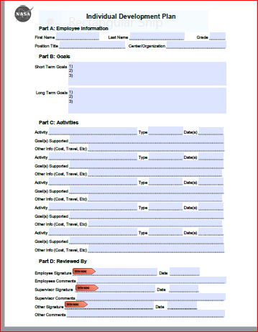
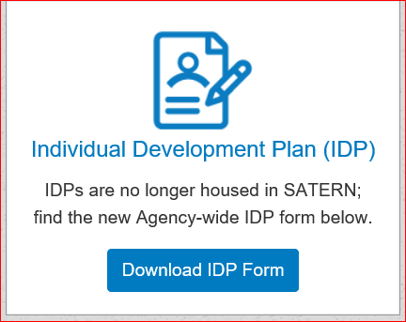
Phase 2 - Create
Create draft IDP
IDP Template:
SATERN IDP Instructions:
https://satern.nasa.gov/

Slide 15
Phase 3 - Finalize
Review with Supervisor/Mentor
Submit in SATERN
Revise any changes requested from Supervisor
Approve(d) by Supervisor

Slide 16
Phase 4 - Manage
Begin Development Activities
Track Progress
Follow-up and discuss with Supervisor at least each 6 months

