Slide 1
NASA/Goddard Space Flight Center’s (GSFC)
Procurement Operations Division (POD)
New Employee Information Packet
February 2024

Slide 2
Welcome to NASA’s Goddard Space Flight Center . . .
You are an employee of the Office of Procurement, Code 170.
Code 170’s Website: Code 170 - Procurement Operations | National Aeronautics and Space Administration (nasa.gov)

Slide 3

The NASA Vision for Space Exploration
“Exploring new worlds and settling the space frontier…”
https://www.nasa.gov
NASA’s mission is to pioneer the future in space exploration, scientific discovery, and aeronautics research.

Slide 4
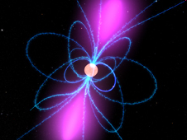
NASA at a Glance
NASA employs 16,000+ civil servants and generates thousands of high tech jobs in the private sector
The Agency operates nine Field Centers and the contractor-operated Jet Propulsion Laboratory. There is a NASA Office of JPL Management and Oversight (NOJMO) and a NASA Shared Services Center. See http://www.nasa.gov/about/sites/index.html for more information on NASA’s Centers and facilities.
Key GSFC facilities include:
  Greenbelt in Maryland
  Wallops Flight Facility in Virginia
  Katherine Johnson Independent Verification and Validation (IV&V) Facility in West Virginia
  Goddard Institute for Space Studies (GISS) in New York.
NASA’s annual budget is approximately $19B.
GSFC’s Office of Procurement, which includes obligating money for NASA Headquarters, is approximately $4B.

Slide 5
NASA Centers and Installations
Glenn Research Center
Cleveland, OH
Goddard Space Flight Center
Greenbelt, MD
Deep Space Network Facilities:
Goldstone, in CA Mojave Desert
near Madrid, Spain
near Canberra, Australia
Marshall Space Flight Center
Huntsville, AL
Katherine Johnson
Independent Verification
& Validation Facility
Fairmont, WV
Goddard Institute
for Space Sciences, NY
Ames Research Center
Mountain View, CA
NASA Headquarters
Washington, D.C.
Wallops Flight Facility
Wallops Island, VA
Langley Research Center
Hampton, VA
Jet Propulsion Laboratory
Pasadena, CA
Armstrong Flight Research Center
Edwards, CA
Kennedy Space Center
Cape Canaveral, FL
NASA Shared Services Center
(NSSC), MS
Johnson Space Center
Houston, Texas
White Sands Test Facility
White Sands, NM
Stennis Space Center
Stennis Space Center, MS
Michoud Assembly Facility
New Orleans, LA

Slide 6

About GSFC . . .
NASA's Goddard Space Flight Center is home to the nation's largest organization of combined scientists, engineers and technologists that build spacecraft, instruments and new technology to study the Earth, the sun, our solar system, and the universe.
http://www.nasa.gov/centers/goddard/home/#.U3JoxRC9aSr

Slide 7
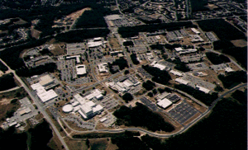
Goddard Space Flight Center
GSFC
Greenbelt, MD
Center Facilities
Location: Greenbelt, Maryland
Acreage: 1121 acres (+149 acres leased from USDA)
# of Buildings: 51
Unique Facilities:
  Diffraction Grating Evaluation Facility, Earth Observing System Data and Information System Facility, Flight Dynamics Facility, High Capacity Centrifuge, Hubble Space Telescope Control Center, Integrated Mission Design Center, Magnetics Test Facility, The NASA Center for Computational Sciences, NASA Communications Network, NASA Space Science Data Center, Network Control Center, Quality Assurance and Detector Development Laboratory, Scientific Visualization Studio, Space Environment Simulator, Spacecraft Fabrication Facility, Spacecraft Systems Development and Integration Facility, Spacecraft Test and Integration Facility
Supporting Facilities:
  Wallops Island located near Chincoteague, Virginia (6188 acres, 84 buildings including aircraft hangars)
  Independent Verification and Validation Facility (IV&VF) located in Fairmont, West Virginia
  Goddard Institute for Space Studies (GISS) located at Columbia University in New York City
Center History
Founded:
  May 1, 1959 (NASA’s first Space Flight Center)
Origin:
  GSFC was formed in 1959 with about 160 researchers from the Naval Research Lab (project Vanguard). A tract of land was identified near the Beltsville Agricultural Research Center and its ownership was negotiated between the US Government and the State of Maryland. GSFC is named in recognition of Dr. Robert H. Goddard, the pioneer of modern rocket propulsion in the United States. Wallops Flight Facility was established in 1945 under the National Advisory Committee for Aeronautics and became Wallops Station in 1958 as part of NASA.

Slide 8
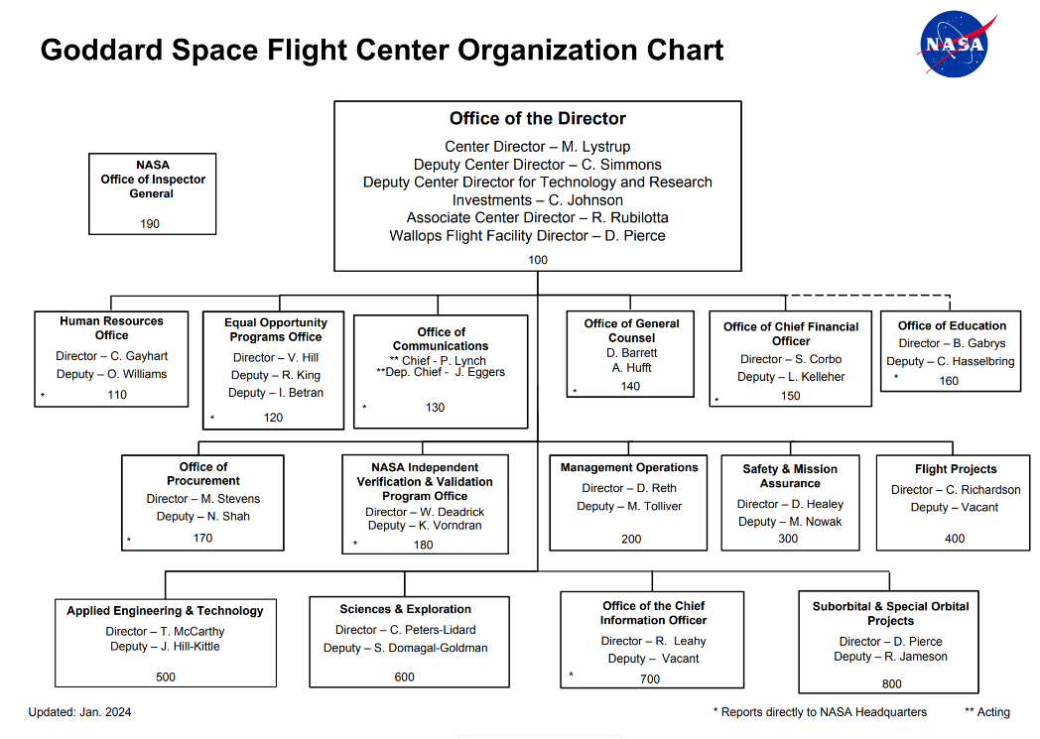
All Directorates and most Staff Offices have their own organizational breakdowns. This breakdown is located on the Center’s internal website at https://internal.gsfc.nasa.gov/information-about-goddards-organizations.

Slide 9
170
CODE
NASA / GSFC Office of Procurement
Director / Procurement Officer
Mary Stevens
Deputy Procurement Officer for Acquisitions
Nipa Shah
Associate Chief for Operations and Business Management
Cindy Cherrix
Deputy Procurement Officer for Policy
Brian Leyda
CODE 171
JPSS / SSMO
Joint Polar Satellite System / Space Science Management Office Procurement Office
eric newman
Associate Chief
CODE 172
GOES
Geostationary Operational Environmental Satellite / Space Weather
tammy seidel
Associate Chief
CODE 173
HEADQUARTERS
Headquarters Procurement Office
jennifer o’connell
Associate Chief
CODE 174
INSTITUTIONAL
Institutional Procurement Office
delia robey
Associate Chief
CODE 175
ENGINEERING
Engineering Procurement Office
alicia carter
Associate Chief
CODE 176
PROGRAM
Program Support
Procurement Office
carlos mckenzie
Associate Chief
CODE 177
SPACE SCIENCES
Space Sciences Procurement Office
steve lloyd
Associate Chief
CODE 178
EARTH SCIENCES
Earth Sciences Procurement Office
ayana briscoe
Associate Chief
Procurement Managers
maikeyza brown
candis edwards
maria mcnamee
lakeshia rawlings
karen smith
pauline barrett
ricarda mason
antwan reid
Anthony lyas
lashawn feimster
malika graham
craig keish
michelle padfield

Slide 10
How We Are Organized
Division Office –Change Management, New Business and Acquisition Strategic Planning, Source Evaluation, Human Capital Planning, Policy, Acquisition Review, Career Development and Training.
JPSS/SSMO (171) - Located at Greenbelt, supports Joint Polar Satellite System Program and the Space Science Mission Operations project (SSMO).
GOES/Space Weather/Planetary (172) – Located at Greenbelt, supports Geostationary Operational Environmental Satellite-R Series (GOES-R) Flight Program and Space Weather Follow-On (SWFO) hardware development contracts for the spacecraft and instruments
Headquarters (173) – Located at Greenbelt and supports all acquisitions needs for Headquarters operations and staff offices. Also supports code 100.
Institutional (174) -Located at Greenbelt and Fairmont, WV supports all acquisition needs related to GSFC’s infrastructure support for the Greenbelt and Wallops campuses as well as acquisition support for the IV&V facility (Code 180). Also supports the Rapid Spacecraft Development Office (RSDO).
Engineering (175) – Located at Greenbelt and supports all acquisition needs for the Engineering & Technology Directorate
Program Support Office (176) – Located at Greenbelt, supports all acquisition needs for a portion of the Flight Programs and Projects for cross-cutting requirements such as communications, networks, and mission operations, and the Office of Safety and Mission Assurance. Also supports the Suborbital and Special Orbital Projects Directorate located at WFF.
Space Science (177) –Located at Greenbelt and supports a portion of the Sciences and Explorations Directorate as well as a portion of the Flight Programs and Projects Directorate for space science and missions such as those related to planetary, lunar, and solar.
Earth Sciences (178) – Located at Greenbelt and supports a portion of the Sciences and Explorations Directorate as well as a portion of the Flight Programs and Projects Directorate for earth science and
missions such as those related to weather, remote sensing earth observing. Also, Planetary Instrument and Payload Projects.

Slide 11

Procurement Operations Division
Our Vision:
Excellence in an evolving acquisition environment
Our Mission:
Establish partnerships that deliver optimal business solutions – one procurement – one mission– one customer at a time

Slide 12

Procurement Operations Division (Continued)
Our Strategic Goals:
Be a premier organization by providing, promoting, and fostering:
  High quality products and services
  Outstanding customer service
  Mutual respect among well-developed, committed employees
  A safe, inclusive, and open environment

Slide 13

Procurement’s Management
Team
The Office of Procurement Associates strategically align resources, processes, and business lines to the mission, goals, and objectives of its customers.
The Procurement Managers implement those strategies and provide full-service acquisition support for the present and the future.
Policy provides the regulatory, policy, and operational perspective.
Together, these individuals form Procurement’s Management Team. More specifically the team is comprised of:
  Division Management: Division Chief/Procurement Officer, Associate Chief/Deputy Procurement Officer, Associate Chief for Operations and Business Management, and the 8 Associate/Assistant Division Chiefs
  Procurement Managers (PM’s): 2 PM’s in each Office except for HQ, there are 3 PM’s
  Policy: Supporting policy, file review, competitions, training and development, source evaluation, and systems

Slide 14
Our Skill Groups
Management
Contracting Officers/Contract Specialists
Procurement Analysts
Administrative Support
Our total workforce ranges between 160-170, and we are located throughout the Center, as close to our requirements organizations as possible.

Slide 15
What We All Do
Provide operational procurement support to NASA Headquarters and GSFC from planning requirements through closeout of contractual instruments:
  Acquisition strategy
  Negotiation
  Award
  Administration
  Closeout
  Source Evaluation Board activities are a separate process from day-to-day acquisitions
Respond to external communities
  Industry, especially small businesses
  Government Accountability Office (GAO), Office of Inspector General (OIG)
  Congressionals
  Headquarters Procurement Surveys every other year, Self-Assessments required once a year, support Survey activity at other Centers
  Regular high-level reporting of data and data drill requests

Slide 16
What We All Do (Continued)
Support Agency and Center Initiatives (examples)
  Category Management
  Strategic Sourcing
  NASA Acquisition Innovation Launchpad (NAIL)
  NASA 20240
Provide infrastructure support to all aspects of acquisition
  Policy, including review function
  Electronic Systems
  SEB Coordination
  Workforce Planning, Training and Development
Typically, 85% of NASA’s budget is spent on contracts and other acquisition instruments.

Slide 17
POD Procurement Obligations
FY 2013 – FY 2023
* GSFC/HQ documents minus bank cards and outside buying (PGrps beginning with G* and H*, not GSFC/HQ Plant/Money obligated by NSSC, etc)
Source: BOBJ Report PRRPT7 – FY
Notes:
17

Slide 18
FY 23 Actions
FY23 Actions | Contracts | BPAs | CA's | PO's | Calls/Orders | IAAs | Total
Base | 68 | 4 | 0 | 10 | 216 | 39 | 337
Mod | 1,984 | 136 | 13 | 24 | 1,216 | 295 | 3,668
Total Actions | 2,052 | 140 | 13 | 34 | 1,432 | 334 | 4,005
Total FY Obs | $2,879,451,838 | $0 | $32,013,050 | $11,360,876 | $378,317,911 | $322,339,796 | $3,623,483,473

Slide 19

Procurement Systems
NASA uses a variety of Agency and Federal Systems and websites in support of the acquisition process.
View the Procurement Systems Overview for general information and guidance.

Slide 20

Roles and Responsibilities of Management
Procurement Officer, Deputy Procurement Officer, and Associate Chief for Operations and Business Management*
  Advocating and negotiating resources (e.g., training, travel, awards, promotions, hiring)
  Participation in Agency and Center activities, such as:
    Human Capital Strategy
    IT Security Requirements
    Programs/Projects: NSSC, Security, PPS, and strategic sourcing contracts
  Final approval of any and all acquisition matters depending on dollar value, unless delegated
  Special request acquisitions (usually an Agency or Center initiative)
  Training (for staff, Associates, Leadership)
  Travel (for staff and Associates)
  *See page 8 for Code 210 organizational chart

Slide 21
Roles and Responsibilities of Management (Continued)
  Timecards for staff and Associates
  Promotions above FPL (normally through Competitive ad)
  External office movement, including outside the Division
  Hiring, details into 170, and competitive actions
  Performance Planning for all and Evaluation for staff and Associates
Associate Division Chiefs *
  Extension of the Division Chief
  Division Representative
    Pre-MSR’s and MSR’s
    Key Customer Meetings
    PSM’s and SEB’s
  Acquisition Planning (may delegate further)
  Key Customer Interface and Visible Presence at Directorate and Headquarters level
  All acquisitions unless Chief requests otherwise
  Training (except competitive Leadership courses) Requests

Slide 22
Roles and Responsibilities of Management (Continued)
Associate Division Chiefs (Cont’d)*
  Travel Orders
  Timecards for PM’s
  Promotions up to FPL
  Internal office movement
  Routine personnel actions
  Telework, FWS, Time-off for school (in accordance with Division policy)
  Performance Planning and Evaluation for PM’s
  Approve Individual Development Plans (IDP’s)
  Action Items, as assigned
Procurement Managers*
  Acquisitions up to designated authority
  Training, Travel, Awards as delegated by the Associate
  *See page 8 for Code 170 organizational chart

Slide 23
Roles and Responsibilities of Management (Continued)
Procurement Managers (Cont’d)*
  Time Cards for employees and Employee Work Schedule Management
  Performance Planning and Evaluation for Employees
  IDP Development with Employees
  Direct Customer interface
    Attends Program/Project Staff Meetings
  Heads Procurement Development Teams (unless delegated)
  Assigns work
  Supervises employees (includes coaching)
  Works with the Associate in Career Development of employees
  Source Evaluation Boards (SEB’s)
  Performance Evaluation Boards (PEB’s)
  PSM’s
  Responsible for basically everything related to day-to-day procurement operations
  *See page 8 for Code 170 organizational chart

Slide 24
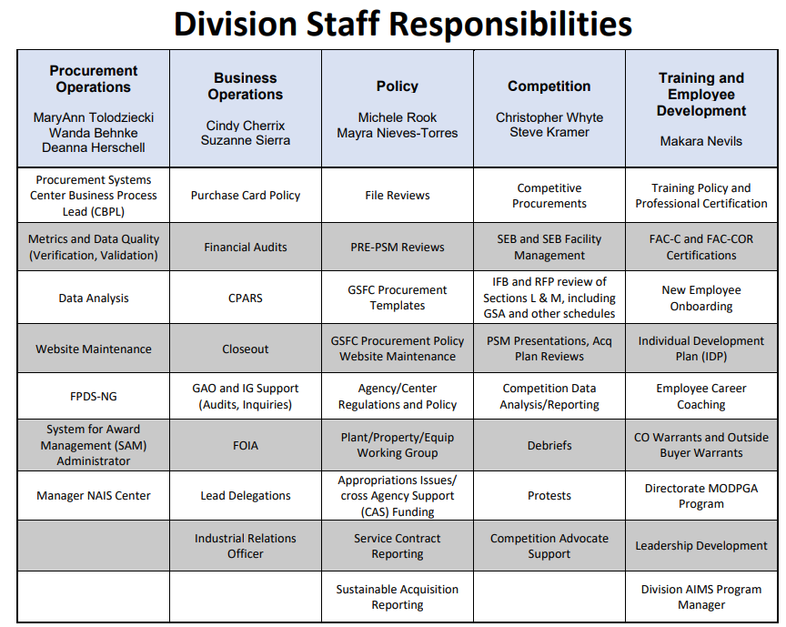

Slide 25
Developing and Managing the Acquisition Workforce
OFPP Policy Letter 05-01 establishes uniform core training requirements for Federal acquisition certifications.
As a contracting professional, you will need to successfully complete significant course work to become “certified.”
  FAC-C Professional Certification
    Initial certification requirements and continuous learning requirements
  Please note certification effects promotion progression above full performance level and ability to obtain a Contracting Officer’s warrant.
  FAI Cornerstone on Demand (FAI CSOD) is the online registration system for federal civilian acquisition workforce training and the system of record for all federal civilian acquisition certification programs. FAI CSOD is used to maintain training records, certification information, continuous learning, and to register for acquisition-related courses.
    FAI CSOD serves as the source for FAC-C training/continuous learning, certification applications, processing and maintenance.
    All contracting professionals (GS-1102 Series) are required to create and maintain an FAI CSOD account.
During your first few weeks, you should schedule an appointment with Makara Nevils to go over requirements, prior course work, and current certification, if applicable. She will help you with your planning and advise you of upcoming classes.

Slide 26
Individual Development Plans (IDP’s)
An IDP is a tool to track the projection and completion of all required courses, on ­the job training, and self-­development activities.
An IDP is an element of the career development program prepared by the individual with the active involvement of the supervisor. The plan is signed by the employee, the immediate supervisor and the next level above the supervisor. The IDP should be discussed upon your arrival, before and during after the performance appraisal process.
The IDP should include as a minimum:
  Short term (1 year) and long term (5 year) career goals and objectives
  Training needs, especially those tied to certification requirements
Makara Nevils can also assist you with this activity.

Slide 27
Individual Development Plans (Continued)
The IDP can also include:
  Rotational, detail, and on ­the-job assignments, as appropriate
  Priority, method and purpose of training
  Other professional development and mentoring assignments, if applicable
  Continuing training in current events in procurement and issues, etc.
Ideally, the IDP should be reviewed and updated jointly every six months to reflect completed training and work assignments and changing needs of the individual. Involvement in other developmental activities should be noted. This can be done in conjunction with the mid-term review of the employee’s Performance Plan.

Slide 28
Other Training Requirements
In addition to the Federal Acquisition Certification in Contracting (FAC-C) Program, employees of the Center are often required to take training in other areas. Examples include:
  Basic IT Security Training - mandatory for all and required annually. This course is accessed through the Agency on-line training system (SATERN).
  Annual Ethics Training is mandatory for contracting professionals and is required annually. This course is also accessed via SATERN. In person training sessions also available.
  Equal Employment Opportunity (EEO) and Diversity-sponsored courses on an as-required or needed basis. Examples include:
    Sexual Harassment
    Alternative Disputes Resolution
    Basic EEO Requirements
The FAI CSOD and SATERN systems also offer self-paced and instructor led training courses.

Slide 29

Procurement All-Hands and Training Forums
There are several ways to meet employees in the Division and learn about your profession. Talk to your Manager and peers about:
  Procurement All-Hands
  Procurement Training Forums
  HQ Quarterly Webinar
  New Employee Group
  Climate Advisory Team (CAT)
  Meet the Management Team
  Center DEIA Events
  Management Operations Directorate Diversity and Inclusion (MODDI) Committee
  Center Employee Resource Group Events

Slide 30
General Employee Information
The next set of charts provide you general information on:
  Information related to your onboarding
    Goddard New Employee Orientation
  Phones and Phonemail
  Email and Computers
  Our Website
  Other Websites of Possible Interest

Slide 31
General Info on Phones & Phonemail
NASA Directory Locator: NASA Employee Directory
For Toll-Free Phonemail access: 1-877-776-4117
    Voicemail Web Interface: https://voipvoicemail.gsfc.nasa.gov/inbox/
    For Telephone Repairs 6-3100
For Internal Calls to Greenbelt: Dial 6 + 4-digit # or 4 + 4-digit #
For calls to Wallops: Dial 7 + 4-digit extension
For local and long distance calls outside of GSFC: Dial 9 + 10-digit number
For complete phone instructions: https://itcd.gsfc.nasa.gov/content/ngv-end-user-device-details

Slide 32
General Information on
Procurement’s Website
Web Site: https://code200-external.gsfc.nasa.gov/210/
Our home page links commonly used Acquisition/Procurement Process tools in one place.
Our Website is divided into 5 distinct categories:
  Division Policies & News
  Procurement Operations Portal
  Procurement Policy
  Proc Systems Support
  Employee Info and Training & Development
The Procurement Website contains a lot of information, some that is linked to other Websites. We continually assess the effectiveness of this Website. As a new employee, your feedback is especially important to us, particularly as it relates to the ease of finding what you need. Suggestions for improvement may be submitted to Wanda Behnke.

Slide 33
Procurement’s Website Items of Interest
Procurement Operations Portal:
    https://code200-external.gsfc.nasa.gov/210/content/procurement-operations-portal
Procurement Policy:
    https://nasa.sharepoint.com/sites/GSFC-ProcPolicy
Proc Systems Support:
  Proc Systems - Home (sharepoint.com)
Employee Training and Development:
    https://code200-external.gsfc.nasa.gov/210/content/employee-training-development
Review and Approval Matrix (See GSFC Circular 10-01):
  pc10-01.xlsx (sharepoint.com)
NASA Procurement Training Policy:
https://inside.nasa.gov/procurement/career-development-and-training
NASA HQs Office of Procurement: https://inside.nasa.gov/procurement

Slide 34
General Websites of Interest
NASA Home Page: http://www.nasa.gov/
Public Goddard Home Page: http://www.nasa.gov/centers/goddard/home/index.html
Internal NASA: http://www.hq.nasa.gov/:
Goddard Strategic Implementation Plan: https://www.nasa.gov/content/goddard-implementation-plan-in-response-to-the-2014-nasa-strategic-plan
NASA Online Directives & Goddard Directives: http://nodis3.gsfc.nasa.gov/main_lib.cfm
Acronym Listing: https://spaceflight.nasa.gov/cgi-bin/acronyms.cgi
Office of Human Capital Management: https://ohcm.gsfc.nasa.gov/
NASA Individual Development Plan Advisor at https://ohcm.gsfc.nasa.gov/content/coaching
GSFC Telephone Book: https://internal.gsfc.nasa.gov/phonebook?q=phonebook-search-results

Slide 35
Final Thoughts
All employees are encouraged to talk to their Supervisor about their progress on a regular basis and not wait until mid-term or annual appraisal time. Take the initiative to ask questions about your own career throughout the year.
When you feel comfortable with the job you are currently performing or if you feel that you have reached a level of efficiency in what you are currently doing, talk to your Supervisor about other work or developmental assignments.
Ask for assistance, clarification or help. Get to know your procurement teammates and develop a good working relationship with them. Chances are, some of the best answers and insight can be found in your own procurement office, especially your peers.
Bring up ideas, respectfully challenge the ways in which we do business and offer alternatives. Be a part of the solution!
If you have any concerns or need advice outside of your immediate area, this package hopefully offers you a number of alternatives.
35

